Slide 1
Predix Overview

Slide 2
Table of Contents
Predix Platform – Overview
Predix Core/Experience
Predix Asset
Predix Data Insight

Slide 3
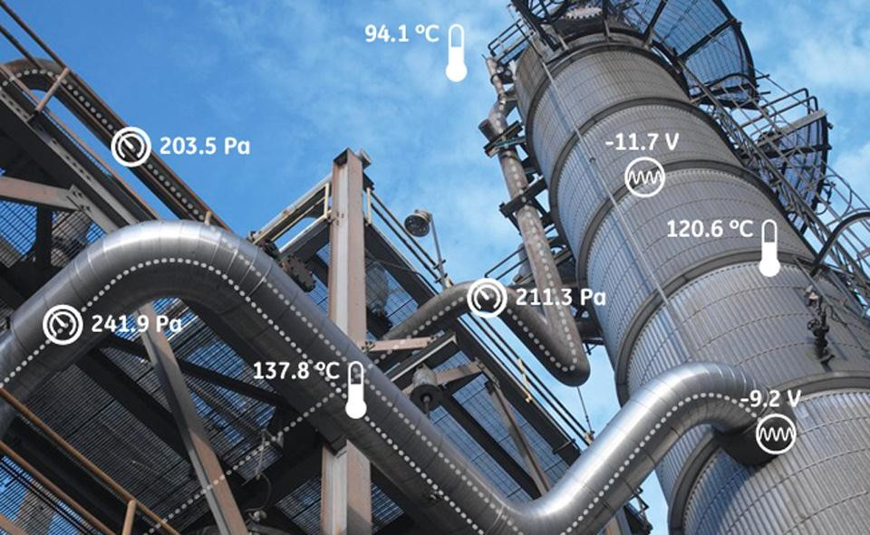

What is Industrial Internet
➢Industrial Internet: Integration of complex physical
machinery with networked sensors and software
Business Case for Predix in GE Power & Water: Flexible Efficiency in Power Plants
Enable Power plants for reacting to
changes in Power demands, Grid
conditions and Fuel supply as they occur
Intelligent Machines powered by real
time Data Analytics
Connected machines have the potential
to increase efficiency and make the
people operating them smarter
May 28, 2014
Proprietary and Confidential
- 3 -

Slide 4
What is Predix
Predix is General Electric's software platform for the collection and analysis of data from industrial machines.
Predix as a cloud-based PaaS (platform as a service) is claimed to enable industrial-scale analytics for asset performance management (APM) and operations optimization by providing a standard way to connect machines, data, and people.
to increase efficiency and make the
people operating them smarter
May 28, 2014
Proprietary and Confidential
- 3 -

Slide 5
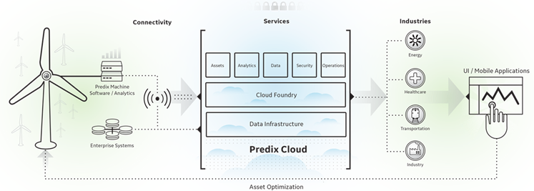
Architecture of Predix
Predix Machine
Software layer for communicating with the industrial asset and Predix Cloud
Predix Connectivity
For scenarios where a direct Internet connection is not readily available
Predix Cloud
Secure cloud infrastructure that is optimized for industrial workloads and meeting regulatory needs
Capable of running local applications, like edge analytics
Enables machines to talk to the Predix Cloud via a virtual network comprised of cellular, fixed line, and satellite technologies

Slide 6
Architecture of Predix - continued
Cloud Foundry
An open source PaaS that supports multiple developer frameworks and an ecosystem
Predix for Developers
Provides developers with a framework to communicate with services.
Predix Services
Services that developers can use to build, test, and run Industrial Internet applications
Provides a micro services marketplace where developers can publish their own services as well as consume
Modular design offers a consistent look and feel, a contextual user experience; Provides comprehensive set of web components

